Slide 1
Alaska Department of Transportation & Public Facilities
“AIAS 101”
Updated Feb. 2015

Slide 2
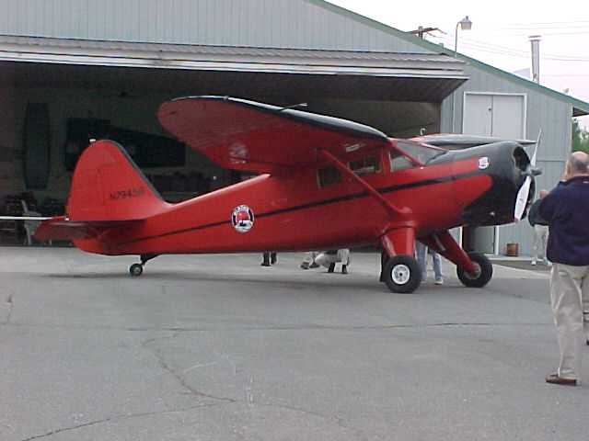
Airports 101 Outline
Nationwide
Statewide
AIAS
Your Airport and You
Anchorage
Fairbanks
Integrity - Enterprising - Excellence - Respect

Slide 3
Nationwide
Integrity - Enterprising - Excellence - Respect

Slide 4
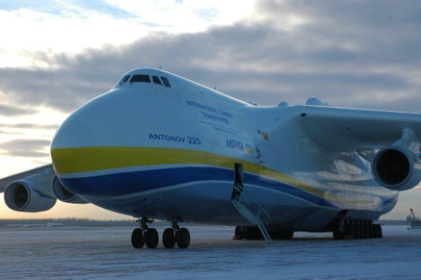
Nationwide
Federal Aviation Administration (FAA): Safety
14 CFR Part 139 prescribes minimum airport safety standards
Airport Certification Manual: how we meet them
Airport Operating Certificate: tells us we meet them
Airport Improvement Program (AIP): funds airport capital improvement projects (up to 93.75%)
Grant Assurances: “contracts” airports must abide by if they receive AIP funding, i.e., not diverting revenue
Snow and Ice Control Plan: “no worse than wet”
Integrity - Enterprising - Excellence - Respect

Slide 5
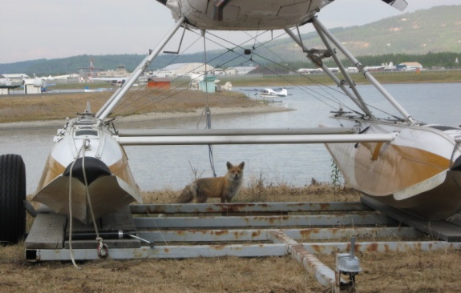
Nationwide
Transportation Security Administration (TSA): Security
49 CFR 1542 prescribes minimum airport security standards
Airports DO NOT manage TSA personnel – they are federal
Airport Security Coordinator: airport contact for all security issues
Airport Security Program: how the airport complies with federal regulations
Secure Areas v. Non-Secure Areas
Badging and Escort Procedures
Integrity - Enterprising - Excellence - Respect

Slide 6
Statewide
Integrity - Enterprising - Excellence - Respect

Slide 7
Statewide
19,700 airports in the U.S.
Over 700 registered airports in Alaska
254 are State owned
Integrity - Enterprising - Excellence - Respect

Slide 8
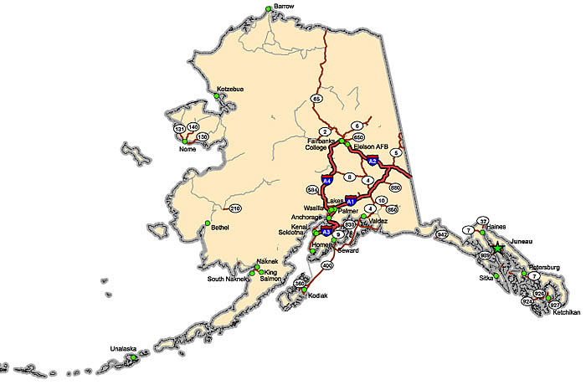
Statewide
Aviation is a necessity in Alaska!
82% of Alaskan communities are not connected to the road system, relying entirely on air service
Only 2% of Alaska’s land area is accessible by roads
Only one road to Lower 48…and it’s 2435 miles from ANC to SEA, the same as a flight from SEA to N.Y.
Integrity - Enterprising - Excellence - Respect

Slide 9
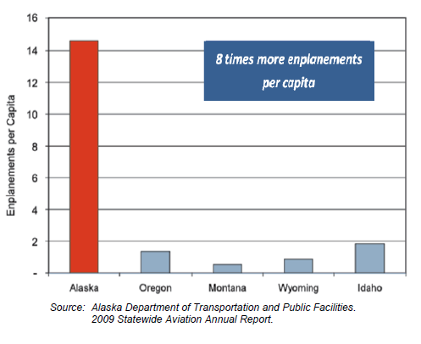
Statewide
Aviation is Business!
8 times more enplanements per capita than any other state
More pilots per capita than any other state
Aviation accounts for approximately 8% of Alaska’s GDP and 10% of all jobs
1 in 10 jobs in Anchorage
1 in 20 jobs in Fairbanks
Integrity - Enterprising - Excellence - Respect

Slide 10
AIAS
Integrity - Enterprising - Excellence - Respect

Slide 11
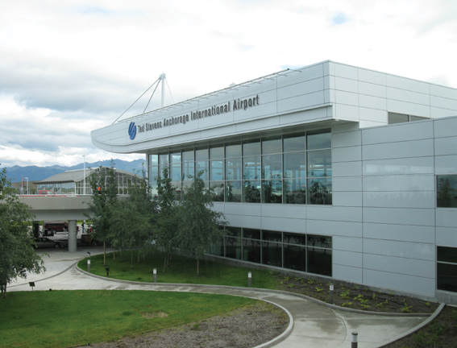
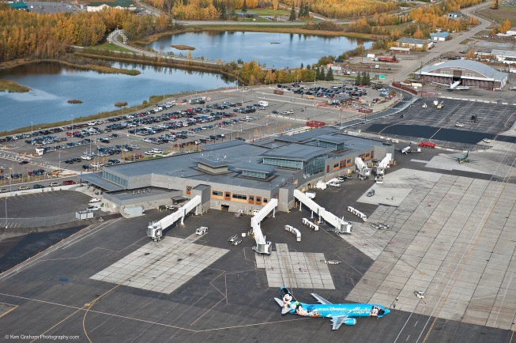
Alaska International Airport System
SINCE 1961
+
=
Two airports under one self-sustaining enterprise fund
To Keep Alaska Flying and Thriving
Integrity - Enterprising - Excellence - Respect
Notes:
The primary air assets the state has to tie together the rural system and provide connection to the rest of the world are the two airports of the AIAS; Anchorage and Fairbanks.
Self-sustaining Enterprise system
Cooperative
Never been simultaneously closed (mountain range, weather systems)
As the two airports operate as a system, the enterprise fund is entirely self-sustaining through the rates and fees we charge the users of the system, and the State General Fund is only tapped for a contribution to the personnel retirement fund.
(Ch88 SLA 1961 - (AS 37.15.410-550)

Slide 12
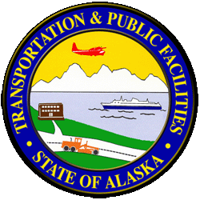
AIAS State Government Structure
Governor’s Office
Department of Transportation
and Public Facilities
Department of Revenue
Alaska International
Airports System
Bond Issuance
Ted Stevens Anchorage
International Airport
Fairbanks
International Airport
AIAS is funded and operates by authority provided in Alaska Statutes
Integrity - Enterprising - Excellence - Respect

Slide 13
Facts and Figures
$85m Operating Budget
Capital Program
“Buckets”
Majority In Interest
481 employees
100 Fairbanks
381 Anchorage
Integrity - Enterprising - Excellence - Respect

Slide 14
Purpose & Values
Purpose:
To keep Alaska flying and thriving
Core Values:
Integrity: Honesty, dependability, unity, and a high ethical standard
Enterprising: Innovative, proactive, pioneering, business-centric airport system
Excellence: Commitment to improve and a passion to provide superior service and infrastructure
Respect: Professional regard for colleagues and customers
Integrity - Enterprising - Excellence - Respect

Slide 15
Vision
By 2030, AIAS is the global nexus for aviation-related commerce
We will be a model government-owned enterprise, adaptive and agile
We will proactively address global changes and world markets
We will operate safely while striving for efficiency
We will be a coveted place to work
We will optimize our contribution to Alaska’s economy and quality of life
We will involve, value, and balance the interests of stakeholders
Integrity - Enterprising - Excellence - Respect

Slide 16
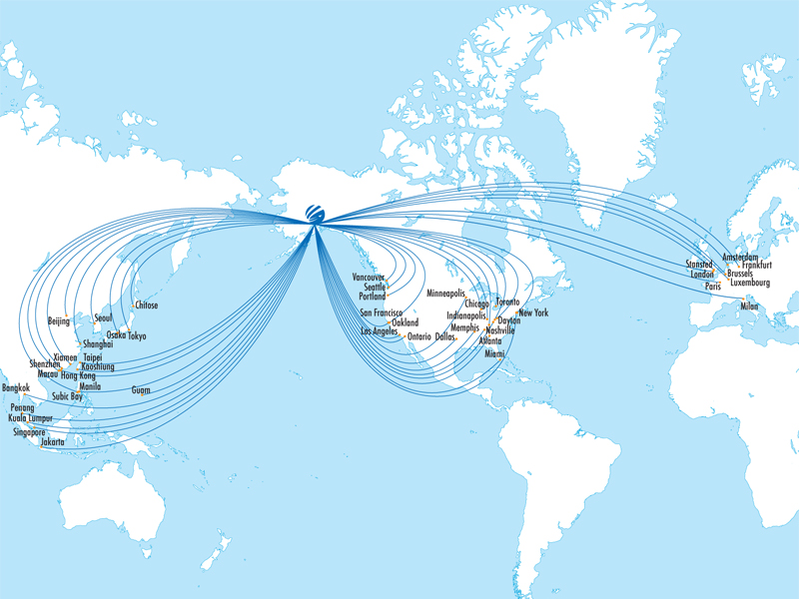
Location
28 Passenger Destinations Served from AIAS
51 Cargo Destinations Served From AIAS
9.5 Hours from 90% of Industrialized Northern Hemisphere
Integrity - Enterprising - Excellence - Respect

Slide 17
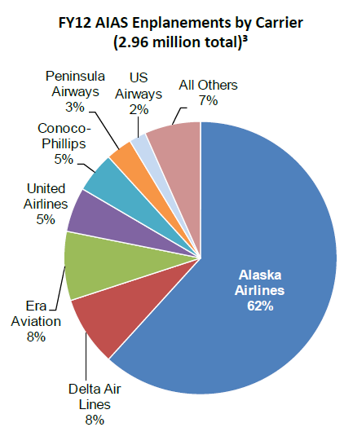
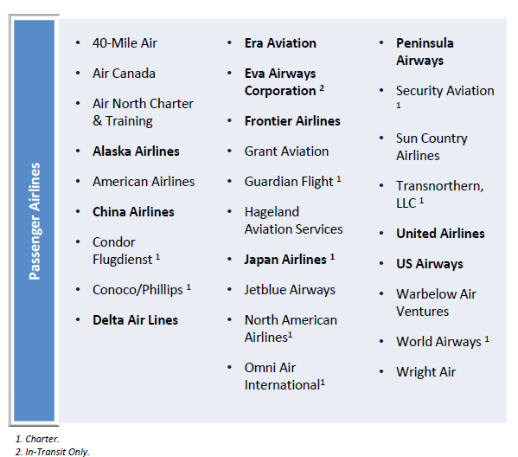
Passenger Customers
Integrity - Enterprising - Excellence - Respect

Slide 18
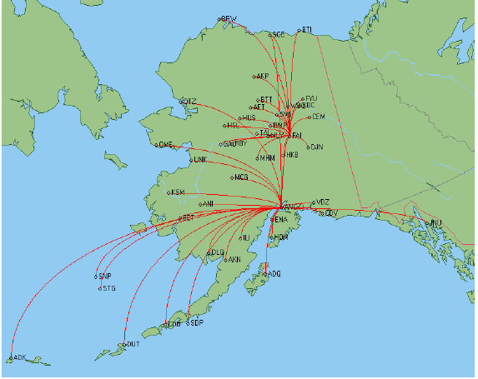
Passenger Markets
Regional Hubs
2.5 million ANC enplanements /year
500k FAI enplanements/year
Integrity - Enterprising - Excellence - Respect

Slide 19
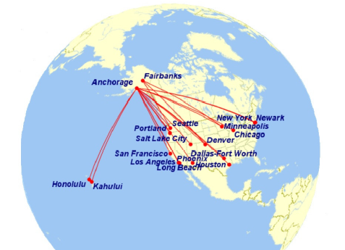
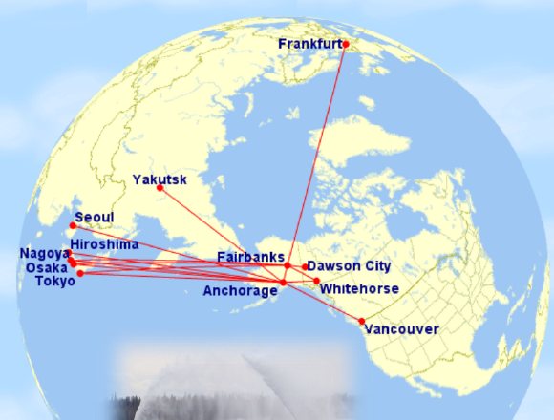
Passenger Markets
Domestic and International Gateways
Integrity - Enterprising - Excellence - Respect

Slide 20
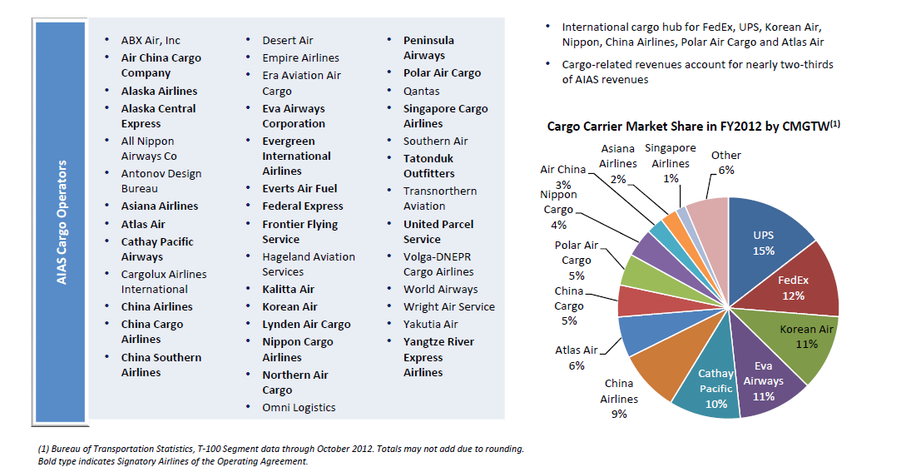
Cargo Customers
Integrity - Enterprising - Excellence - Respect

Slide 21
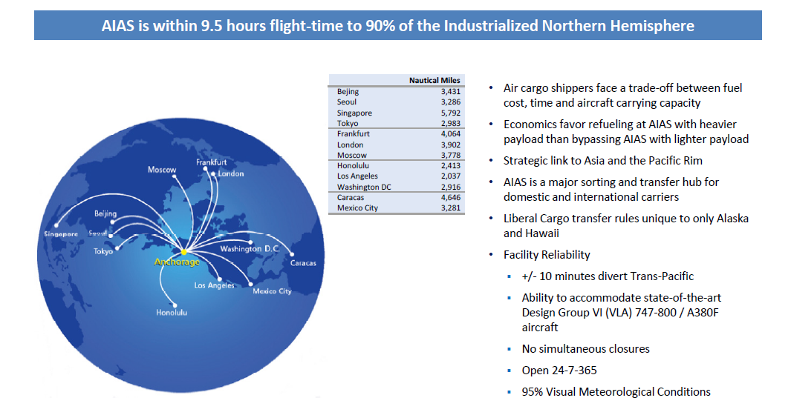
Cargo Markets
Integrity - Enterprising - Excellence - Respect

Slide 22
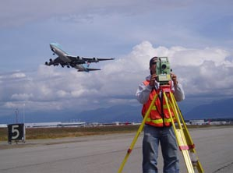
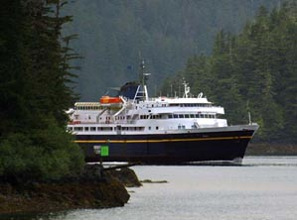
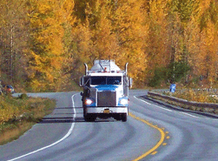
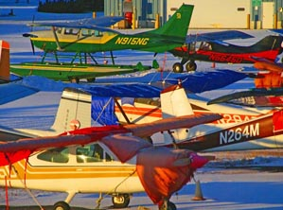
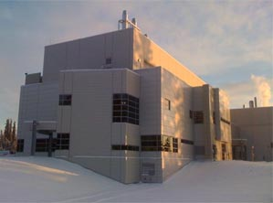
Payload vs. Range
PVG-ORD Direct
Distance: 7,050 miles
Payload: 170,000 lbs
77,273 kg
PVG-ANC-ORD
Distance: 7,150 miles
Payload: 295,000 lbs
134,090 kg
At $1.00 per lb:
PVG-ANC-ORD = $295,000
PVG-ORD = $170,000
ANC Stop = $125,000
For 747-8F:
Increased Revenue with ANC stop is $125,000
$125,000 x 5 days/week x 52 weeks = $32,500,000

Slide 23
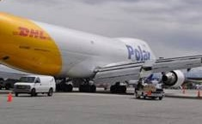
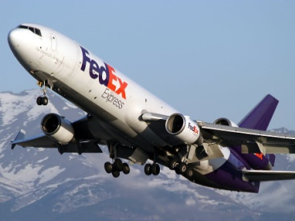
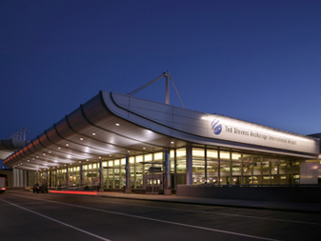
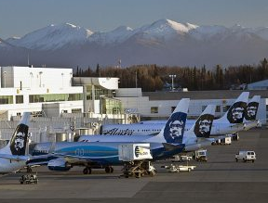
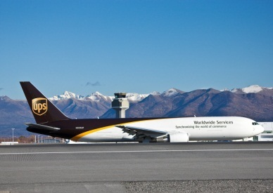
US/Global Air Cargo Airport Rankings
Rank | City
1 | Memphis
2 | Anchorage
3 | Louisville
4 | Miami
5 | Los Angeles
6 | Chicago
7 | New York
8 | Indianapolis
9 | Newark
10 | Atlanta
Rank | City
1 | Hong Kong
2 | Memphis
3 | Shanghai
4 | Incheon
5 | Dubai
6 | Anchorage
7 | Louisville
8 | Frankfurt
9 | Paris
10 | Tokyo
Data from Airports Council International for CY2013 metric tons cargo
Integrity - Enterprising - Excellence - Respect
Notes:
Dropped from 4th to 6th in the world 2012 to 2013. In part due to the slow decline in cargo traffic at ANC, but also due to significant growth at Dubai and Incheon. ANC is just barely behind both of them and about 200,000 tons ahead of #7 ranked Louisville.
Our tonnage is primarily throughput, not very much cargo handling happens in Alaska.

Slide 24
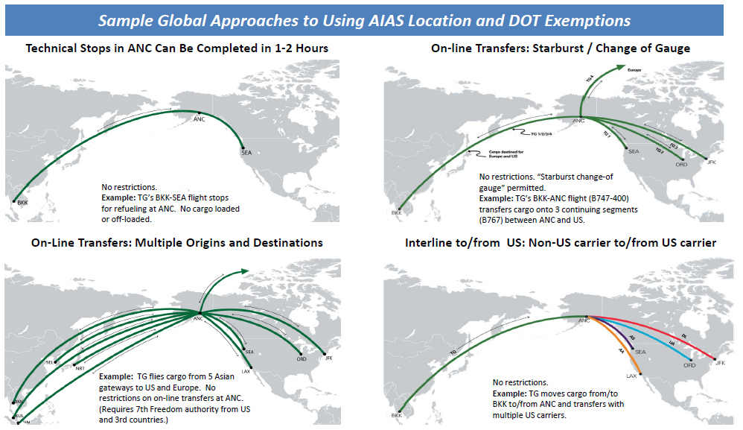
Cargo Transfer
Liberal cargo transfer rules expand markets
Integrity - Enterprising - Excellence - Respect

Slide 25
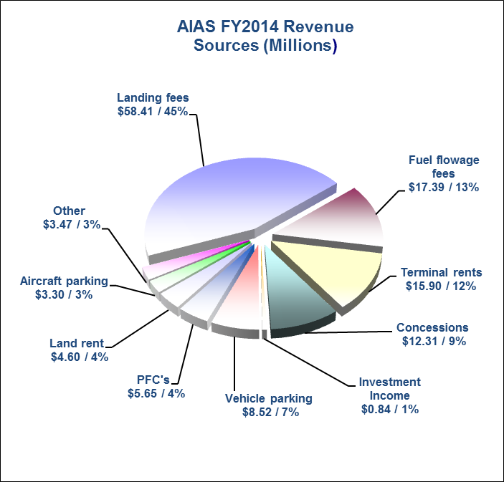
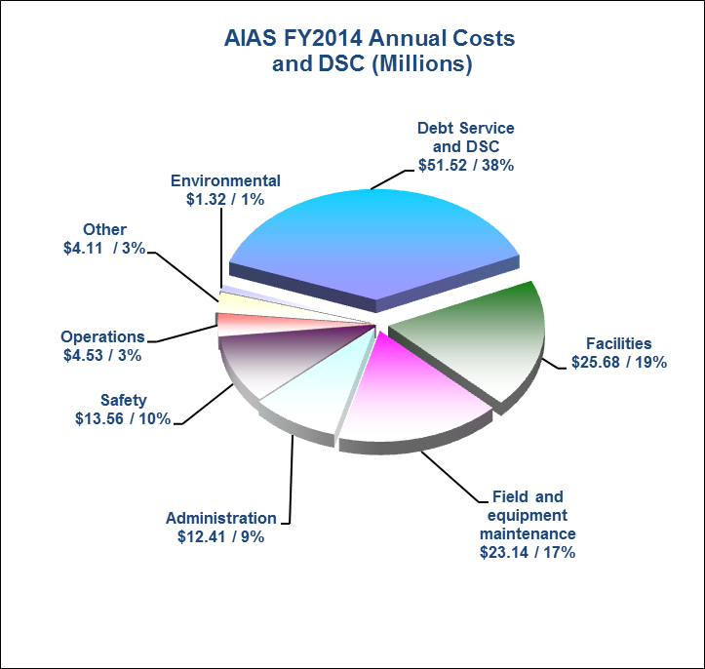
Annual Revenues / Operations, Maintenance and Debt Costs - Funded from Customer Charges -
$130M in Operating/Other Revenues
Integrity - Enterprising - Excellence - Respect
Notes:
Here is a picture of our system annual revenues and costs for FY14.
Approximately $130m in annual operating revenues (including interest income and PFC proceeds) and about $136m in costs, including debt service and coverage (difference represents approx $4m non-cash PERS transfers-in and $2m additional PFC surplus used for debt service) FY14 system assets are approximately $1.5 billion. AIAS has averaged about $50 million per year of Federal capital contributions over the past five years.
Rates and fees charged to customers for use of airport facilities are developed and administered through the AIAS Passenger Terminal Lease and Operating Agreement (OA), a contract between AIAS and each individual member of a majority of its airline customers. As such, our customers, mainly the air carriers, recognize, understand, and endorse via a legally binding agreement that we’ll deal with rising costs or lower activity – fewer takeoffs and landings rooted in a slowed economy – by adjusting what we charge.
~$80M in Operating Costs (net of depreciation)
~$50M in Debt Service and Coverage
I. AIAS sets rates and fees to recover costs and required 1.25x debt service coverage.
II. AIAS uses a “residual rate‐making methodology” which shares some risk with signatory airline customers. Annual shortfall retroactively billed to signatory carriers /surplus funds applied to debt service and capital requirements.
III. Operates with “closed system” goals –
a. no general funds
b. no revenue diversion
IV. Recent year’s activity declines (primarily cargo) have required use of surplus funds and increased rates and fees.
V. Principal financial stakeholders are State, customers, and bondholders.

Slide 26
Other Rates and Fees
Examples:
Commercial vehicles, badging, parking, GA tiedowns, land rents
Always refer to the current Rates and Fees Schedule before quoting
Most rates and fees are consistent between ANC and FAI
Integrity - Enterprising - Excellence - Respect

Slide 27
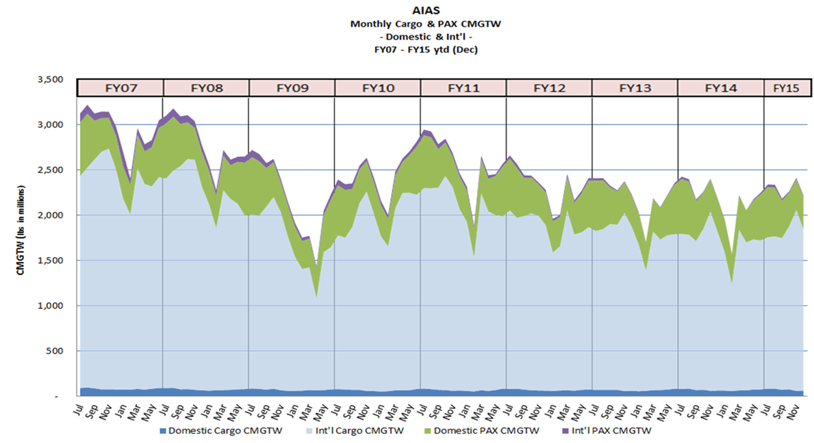
CMGTW Trend
Notes:
Combined Maximum Gross Takeoff Weight
A key indicator of AIAS revenue

Slide 28
Alaska International Airports System Operating Agreement and Passenger Terminal Lease
30 Signatories
Air Canada
Air China Cargo
Alaska Airlines
Alaska Central Express
Asiana Airlines
Atlas Air
Cargolux Airlines
Cathay Pacific Airways
China Airlines
China Cargo Airlines
China Southern Airlines
Condor
Corvus Airlines
Delta Airlines
Empire Airlines
Eva Airways
Federal Express
Frontier Airlines
Kalitta Air
Korean Airlines
Lynden Air Cargo
Nippon Cargo Airlines
Northern Air Cargo
Peninsula Airways
Polar Air Cargo
Singapore Airlines Cargo
Tatonduk Outfitters, Everts Air
United Airlines
United Parcel Service
US Airways
10-Year Agreement
effective July 1, 2013
through June 30, 2023
As of Jan 15, 2015
Integrity - Enterprising - Excellence - Respect

Slide 29
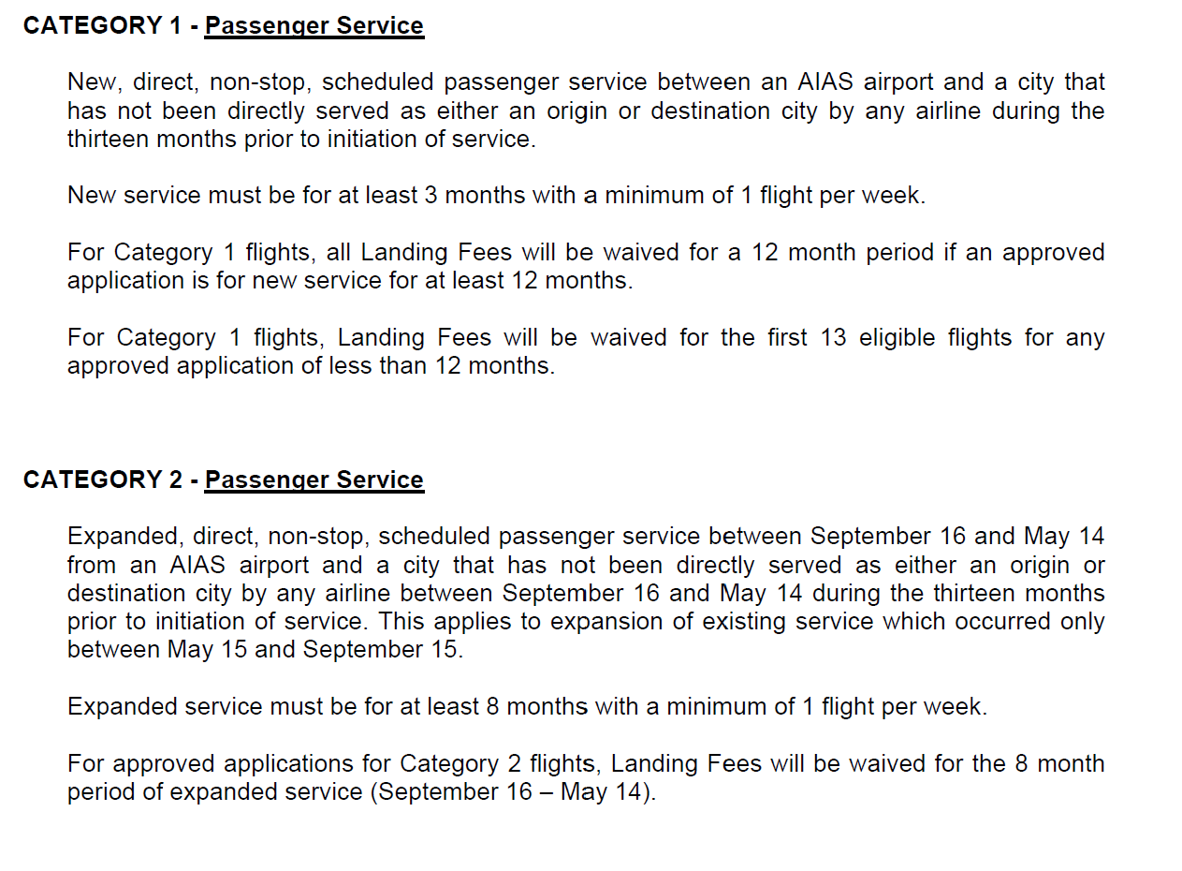
Incentive Programs
Incentive programs exist for:
New or Expanded Regional, Domestic, and International Passenger Service
New or Rescheduled Cargo Service
Refer to Business Development
Integrity - Enterprising - Excellence - Respect

Slide 30
Insert airport specific information
Integrity - Enterprising - Excellence - Respect

